Slide 1
Second Wave: Critical DH
What’s Power Got to Do with It:
Data, Algorithms & Archival Representation

Slide 2
The Power Chapter: Takeaways?
Bias in data & data analysis: data not neutral
Who has the resources to collect data, shape the project, and determine who uses/sees it
Where does the data come from? Who gets to decide if it exists?
Data as a tool of white supremacy

Slide 3
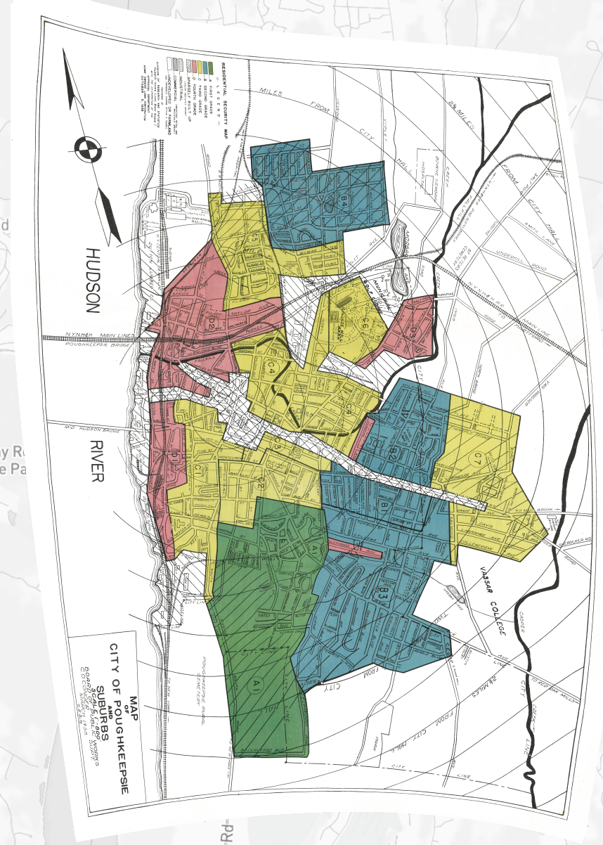
What is Data?
Who creates the data?
How is that data created?
How is the data represented to the public?

Slide 4
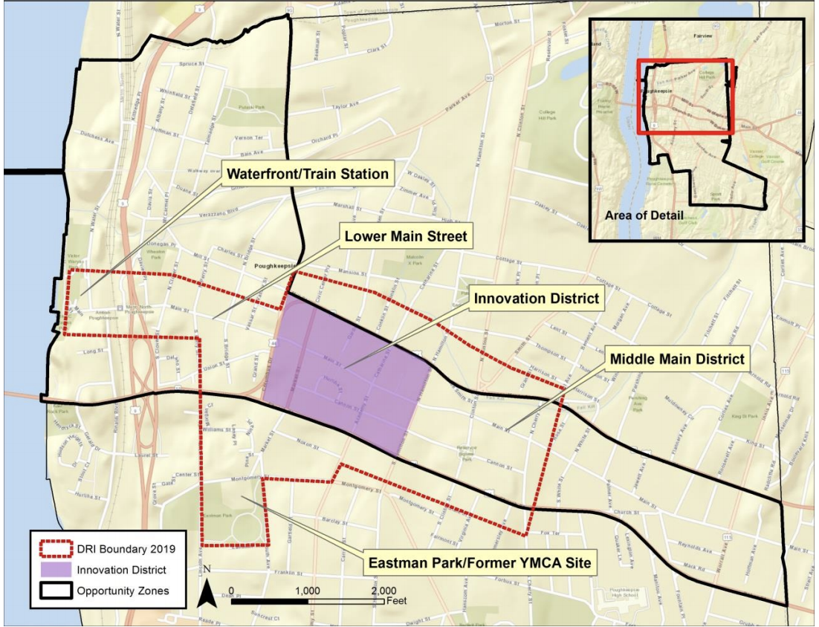

Slide 5
What Do Maps Do? Characteristics?
--organize land
--create a perspective
--God’s view
Aerial views, legends & keys, color and shading to highlight features

Slide 6
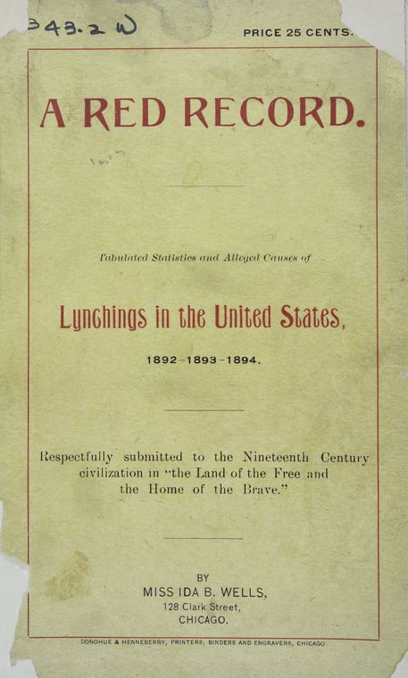
What is Quantification?
Why Does it Matter?

Slide 7

WORLD VIEWS OF MAKERS:
Securing power vs. contesting power

Slide 8
What Characterizes Second-Wave DH Projects
Second Wave of DH
Digitization/Collection of less acknowledged resources
Focus on more equitable scholarship
Increasing number of public humanities projects
Growing categorization and types of DH projects
Consciousness of participants and labor practices of projects
Torn Apart / Separados
SNCC Digital Gateway
Mapping Inequality
DH Awards 2019
Data + Feminism Lab

